Slide 1
Lecture 5
5.2 Defining Functional Cities as Networks
IUS 2.3.3
© Luís M. A. Bettencourt 2023
Notes:
This short module introduces the concept as functional cities (which will be our main unit of analysis) as networks, this will mean defining the space of cities inn terms of all the places of origin and destination where interacting people come from and go to, historically via commuting flows.

Slide 2
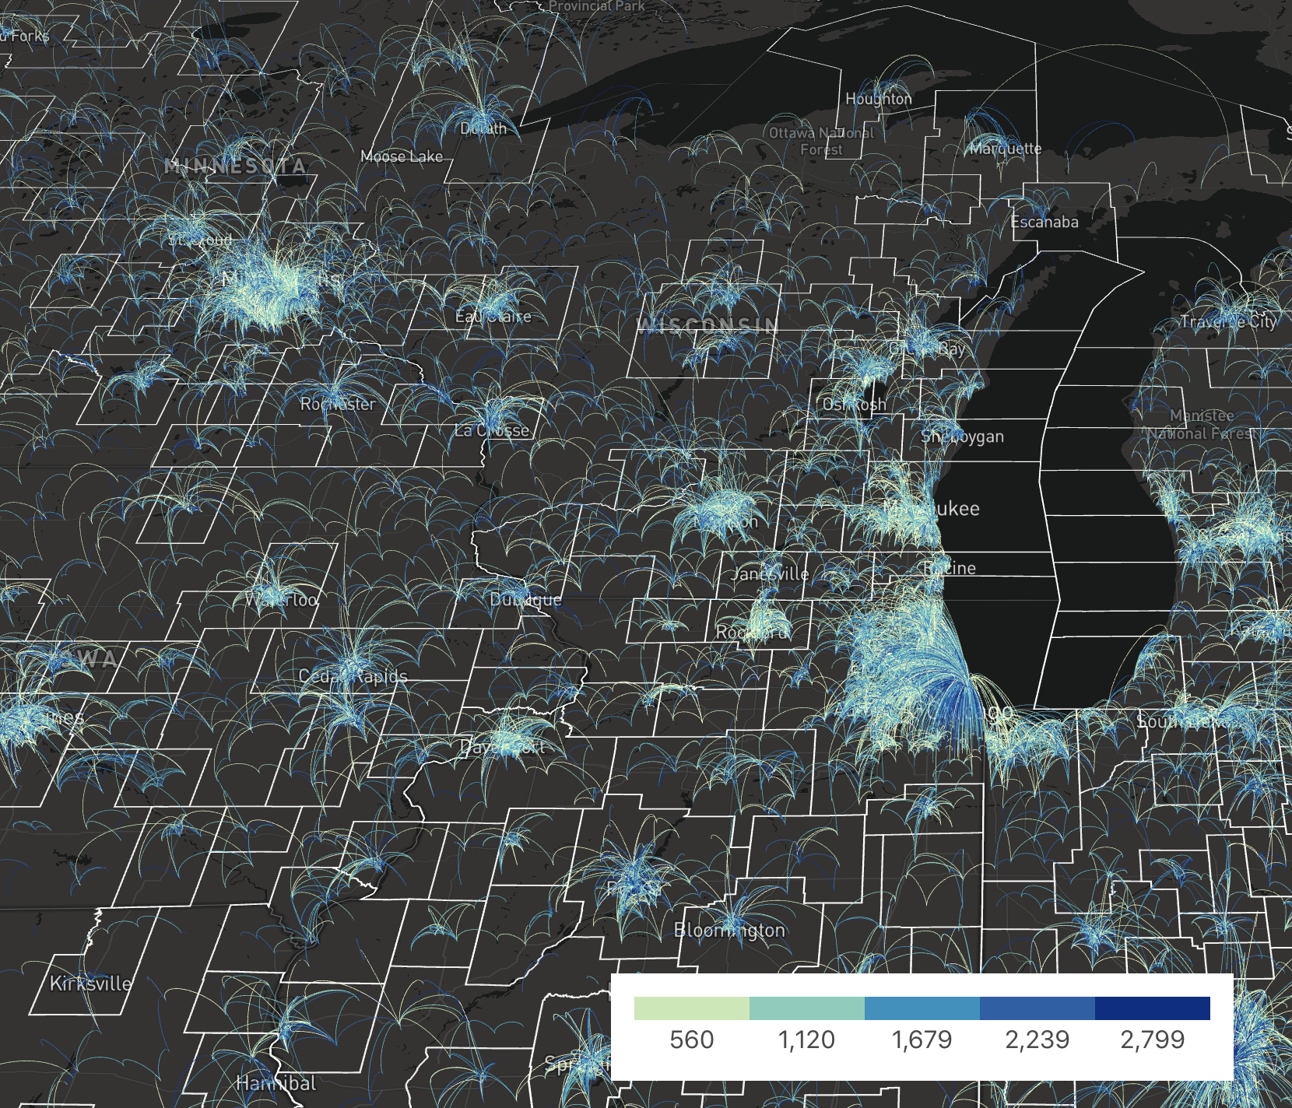
credit: Benjamin Rothschild and Dani Zünd
Metropolitan Statistical Areas
sets of counties, pop > 50,000
Micropolitan Statistical Areas
sets of counties, 10K < pop < 50K
Notes:
This is a dataset on commuting flows “Longitudinal Employer-Household Dynamics”, available here https://lehd.ces.census.gov/data/ the image shows flows around each city and town.

Slide 3
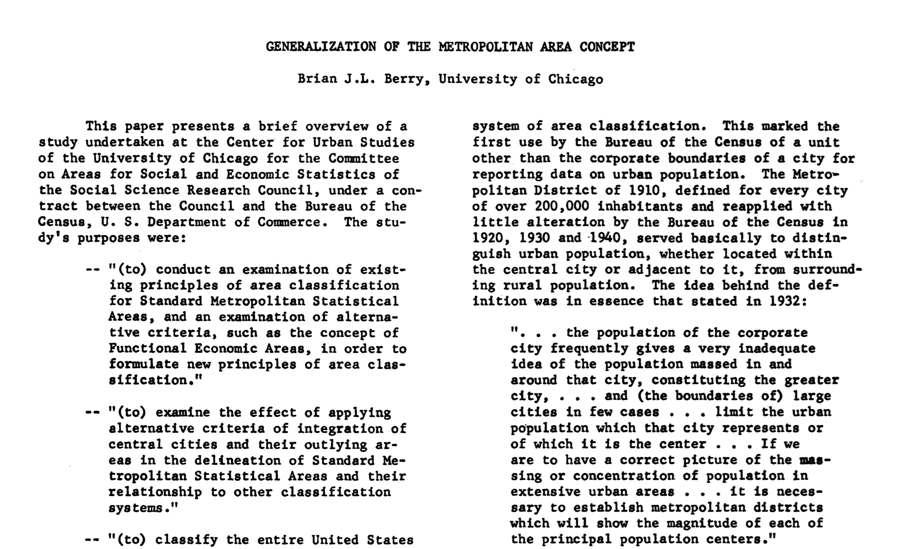


~1968
Notes:
The construction of functional cities driven by interactions, and not political boundaries, became necessary in the US after WWII, with new technologies such as the car and new infrastructure that made urban areas much larger spatially. These became “Metropolitan Areas”

Slide 4
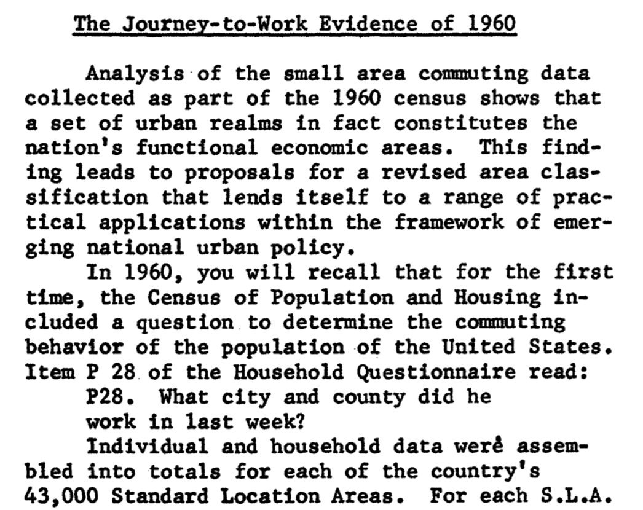

Notes:
These began being constructed in the 1960s, via commuting surveys

Slide 5
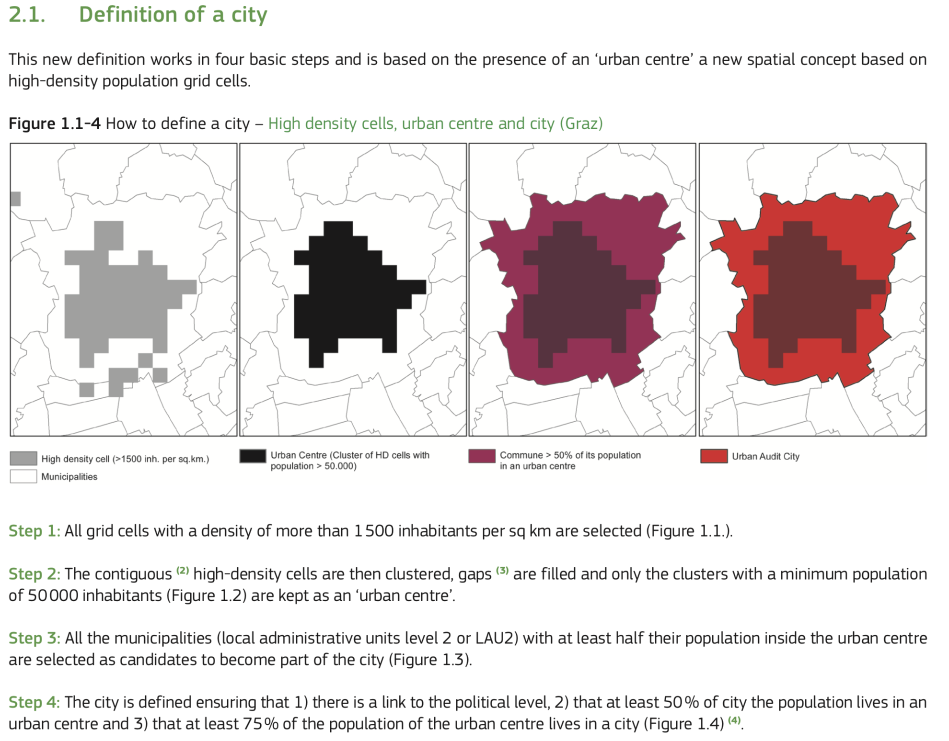
credit: EU/OECD
Notes:
The European Union + the OECD statistics built a finer definition of metropolitan areas in more countries, using remote sensing data. This still requires data about mobility.

Slide 6
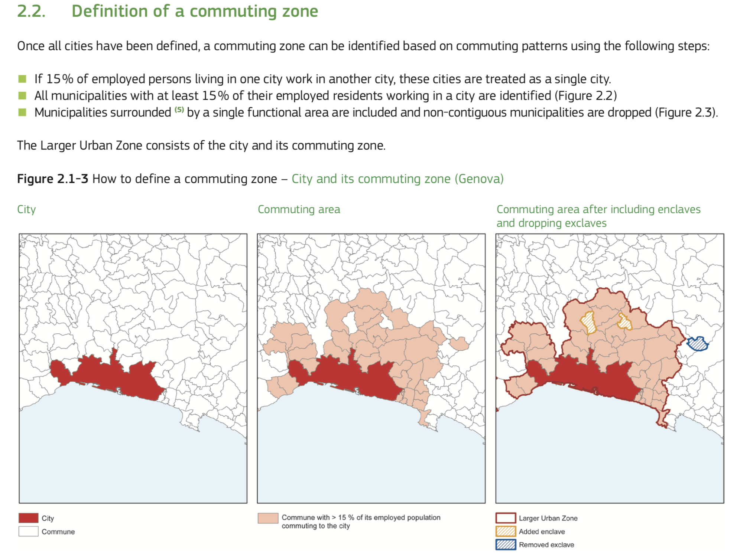
Notes:
As seen here…

Slide 7
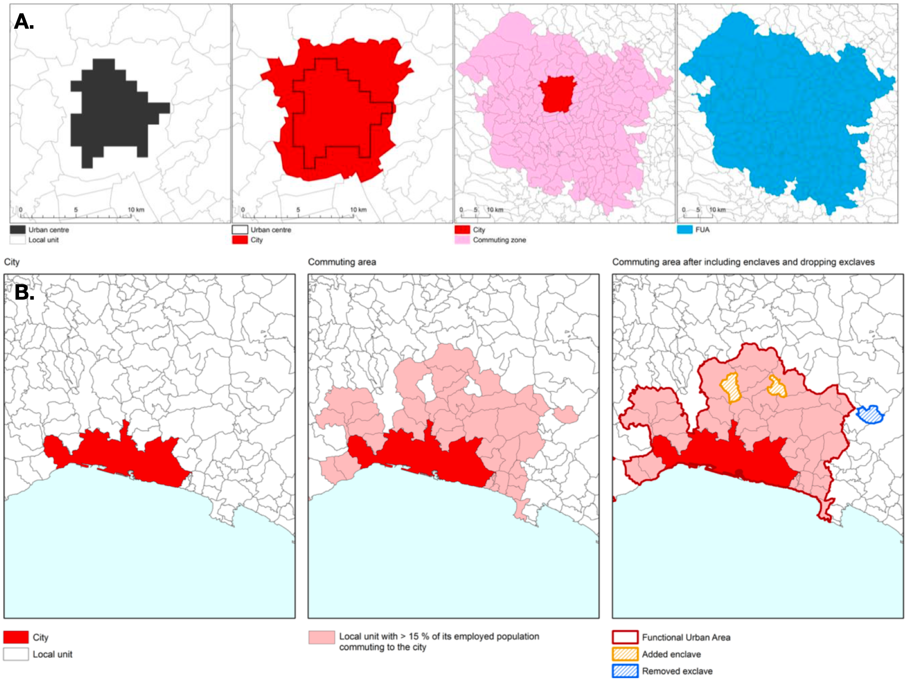
Definition of Functional Cities
metropolitan areas
OECD definition

Slide 8
Procedure
A spatialized residential population map, in their case a given number of people per 1-square kilometer cell. Over the same scale one usually also has a share of built surfaces, from multispectral satellite data.
Digital shape boundaries for local political or administrative units (these typically vary by nation).
Data on commuting flows between these local units and employment per unit.
The subtlest step has to do with using commuting ties. The EU/OECD procedure goes as following:
Include area in the set representing the functional urban area if 15% of employed persons living in one unit, work in another unit. This includes commuting between suburbs and the CBD (in both directions), as well between suburbs and other peripheral units, so that the city need not be monocentric.
Some exceptional units, such as enclaves – disconnected units entirely surrounded by other local units that belong to a commuting zone-- are included to form a convex hull, while non-contiguous local units are dropped from the set. This is not necessary as part of the definition, but has the virtue of creating a single compact boundary line.

